Slide 1
QUIZ/IQ
GAME
GROUP MEMBERS (GROUP ID:11):
Muhammad Zahid 19K-0334
Ahmed Saeed 19K-0159
Muhammad Zayyan 19K-0182

Slide 2
Introduction
We have developed this game to ask user some general IQ based questions in order to calculate his/her IQ. This will help the user to find out his IQ level through this game. This system will also keep track of the players who have played this game. This game will contain different levels of difficulty which are:
LEVEL 1(EASY)
LEVEL 2(NORMAL)
LEVEL 3(HARD)
This project is aimed to build a fully functional game in order to achieve the efficiency of Quiz Game and will help user to improve his/her IQ and in the end of the game the user will find out his/her IQ level and standing with the track of score.

Slide 3
SYSTEM DIAGRAM
ANSWERS OF DIFFERENT LEVEL
QUESTIONS OF
DIFFERENT LEVEL
QUIZ GAME
AND IQ TEST
SCORE GENERATOR FOR DIFFERENT LEVELS
IQ PERCENTAGE
GENERATOR
IQ
LEVEL STANDING

Slide 4
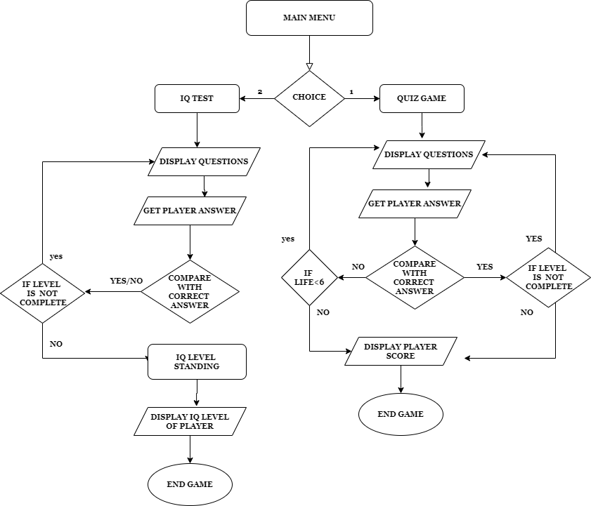
FLOW OF PROGRAM
FLOWCHART:

Slide 5
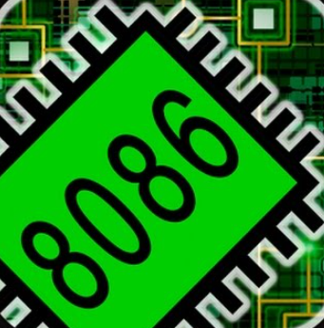


TOOLS AND SERVICES USED
-We used Microsoft Visual Studio and Team Viewer as a source of services which helped us to keep our code updated at same moment allowing us to work together with ease in this situation with the members
-We used EMU 8086 for debugging of our code.

Slide 6
Group coordinations
Ahmed Saeed - Collected his data of Level 1 Questions - Created Data/Functions related to Level 1 - Managed 2D Array/addressing to Level 1 - Created a IQ STAGING function for the player
Muhammad Zahid - Collected his of Level 2 Questions - Created Data/Functions related to Level 2 - Managed 2D Array/addressing to Level 2 - Created a Reward function for the Player
Muhammad Zayyan - Collected his data of Level 3 Questions - Managed 2D Array/addressing to Level 3 - Created Data/Functions related Level 3 - Created a PERCENTAGE function of TOTAL SCORE of player
How we collectively implemented this: We are able to do coordinate remotely using services mentioned. All level questions were compiled in one single program and a main procedure was created where the user was given a choice to either play a Quiz game or an IQ based game. This was done by comparing the choice and calling out the specific function to meet players demand. Data members according to the function were made which were used throughout the program.

Slide 7
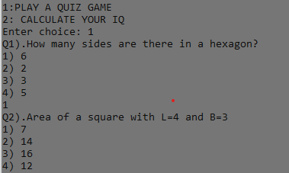
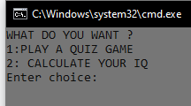
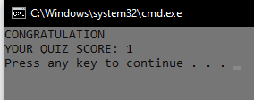
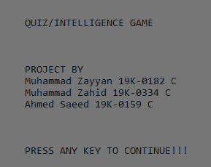
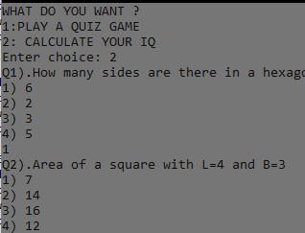
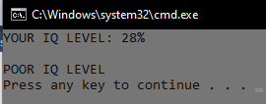

Snapshots of our Program

